Slide 1
The Video Game Industry in Canada
Daniel Schenker
Jordan Woo

Slide 2
Size of the Industry in Canada

Slide 3
How big is the industry in Canada?
Canada is the third-largest employer of video game professionals with over 16,000 employees.
There are an estimated 11,000 more from indirect and induced activity.
Over 348 companies exist in Canada. For the past decade and half, Montreal, Toronto and, eventually, Vancouver have been video game development hotspots.

Slide 4
How about when compared to the rest of the world?
England formerly held the position of third
Third behind Japan and the United States
United States has approximately 32,000 employees

Slide 5
Distribution of Companies per Province
British Columbia: 83
Alberta: 30
Manitoba: 19
Ontario: 96
Quebec: 87
New Brunswick: 3
Nova Scotia: 12
Newfoundland: 8
PEI: 10

Slide 6
Distribution of Employees per Province
British Columbia: 3,882
Ontario: 2,600
Quebec: 8,236

Slide 7
Average Salary per Province
British Columbia: $68,714
Alberta: $55,714
Manitoba: $40,250
Ontario: $62,297
Quebec: $60,450
Atlantic: $72,667

Slide 8
Estimated Amount Spent per Province
British Columbia: $393M
Ontario: $238M
Quebec: $733M

Slide 9
Canadian Game Companies

Slide 10
British Columbia
Hothead Games – Vancouver
Founded: March 2006
Employees: 50
Notable Games:
Penny Arcade Adventures: On the Rain-Slick Precipice of Darkness Ep 1 & 2
DeathSpank series
Hothead self-publishes its games with a focus on offering accessible gameplay and episodic content through digital distribution.

Slide 11
British Columbia
Radical Entertainment – Vancouver
Founded: 1991
Notable Games:
Scarface: The World Is Yours
Multiple Crash Bandicoot games
Prototype
BC’s oldest video game company, founded in 1991 and previously developed games for game publishers such as THQ, Microsoft and Fox Interactive.
It is now an entirely owned subsidiary of Activision Blizzard after being acquired by Vivendi Games in 2005.

Slide 12
British Columbia
Next Level Games – Vancouver
Founded: October 2002
Notable Games:
NHL Hitz Pro
Multiple Mario Strikers games
Upcoming Games:
Luigi's Mansion : Dark Moon
Named one of "Canada's Top 100 Employers" and one of BC's Top Employers in 2008, 2009 and 2012.
The company has been featured in Maclean's magazine and BC Business magazine. Professionalism, craftsmanship and collaboration are the core values at Next Level Games.

Slide 13
British Columbia
Relic Entertainment – Vancouver
Founded: 1997
Notable Games:
Homeworld series
Warhammer 40,000 series
Company of Heroes series
Notable Awards:
Best Developer, IGN.com Best of 2006 Awards

Slide 14
British Columbia
United Front Games – Vancouver
Founded: 2007
Notable Games:
ModNation Racers
Upcoming Games:
Sleeping Dogs
LittleBigPlanet Karting
The studio consists of former members of EA Black Box, Rockstar Vancouver, Radical Entertainment and Volition Inc, all of which made video games with an open world setting

Slide 15
British Columbia
EA Black Box – Burnaby
Founded: 1998
Notable Games:
Multiple NHL games
Multiple Need for Speed games
Multiple Skate games
Originally based in Vancouver, but relocated as part of Electronic Arts' worldwide consolidation plans in 2008.
Founded by former employees of Radical Entertainment

Slide 16
Alberta
BioWare – Edmonton
Founded: February 1995
Employees: ~800 (2010)
Notable Games:
Baldur's Gate Series
Neverwinter Nights Series
Star Wars: Knights of the Old Republic
Mass Effect Series
Dragon Age Series
Noteable Awards:
Alberta's Top Employers by Mediacorp Canada Inc.,
Calgary Herald and the Edmonton Journal. - October 2008
Spike TV's 2010 Video Game Awards: Studio Of The Year (2010)
Hall of Fame induction (2010)

Slide 17
Ontario
Silicon Knights – St. Catharines
Founded: 1992
Employees: Approx 40
Notable Games:
Metal Gear Solid: The Twin Snakes
Too Human
Upcoming Games:
Unknown project for next generation systems, announced November 2011
Silicon Knights first games were real-time strategy/action hybrids for the PC, Amiga and Atari.

Slide 18
Quebec
Behaviour Interactive – Quebec City
Founded: 1992
Employees: 375
Notable Games:
Transformers: Dark of the Moon
Multiple Sims games
Naughty Bear series
Formerly known as Artificial Mind and Movement
Largest independent game development studio in Canada

Slide 19
Quebec
Beenox – Quebec City
Founded: 2000
Notable Games: (Original Development)
Multiple Spiderman games
Monsters vs. Aliens
Guitar Hero Smash Hits
Notable Awards:
Quebec's Best Employer 2008
Between 2002 and 2006, the developer was essentially a porting house

Slide 20
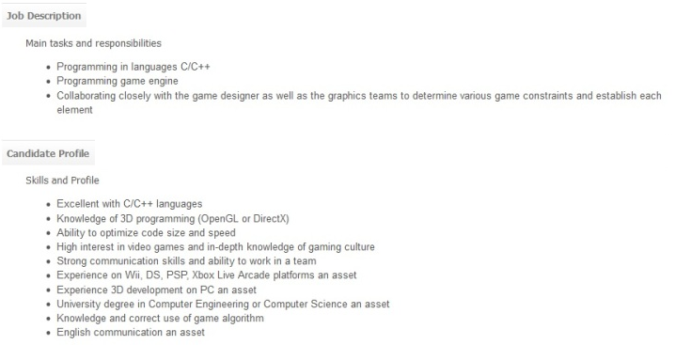
General Job Requirements

Slide 21
Citations
http://www.networkworld.com/news/2010/040610-canada-boasts-the-third-largest-video.html
http://business.financialpost.com/2011/05/30/canadas-home-grown-video-game-industry-shines-on-international-stage/
http://en.wikipedia.org/wiki/Category:Video_game_companies_of_Canada
http://www.theesa.ca/wp-content/uploads/2011/08/SECOR_ESAC_report_eng_2011.pdf http://en.wikipedia.org/wiki/List_of_video_game_developers

